Slide 1
“What’s in a Name?” Stories about Named Buildings on the IUPUI Campus
Stephen E. Towne
IUPUI Special Collections and Archives
University Library
What’s in a name? That which we call a rose/By any other name would smell as sweet.
W. Shakespeare, Romeo and Juliet, Act II, scene ii

Slide 2
IUPUI Committee on Review of Building and Structure Names
Charged July 2020 to research the people whose names are on campus buildings to determine if they held views “inimical to the fundamental values of the university”
Co-chaired by Karen Dace and Stephen Hundley
Over 100 buildings on campus, about 40 of which have names attached
Reported in early 2022 to Chancellor Nasser Paydar with recommendations to investigate further four persons whose names are on campus buildings

Slide 3
Aerial view of IUPUI ca. 1980 UA24-002818

Slide 4
Riley Hospital under construction, 1923 UA24-004126

Slide 5
James Whitcomb Riley (1849-1916) photo courtesy James Whitcomb Riley Museum Home

Slide 6
Ball Residence under construction, ca. 1927 UA24-003526

Slide 7
Ball Residence and Ball Gardens, 2018 Photo by Liz Kaye 20180607_Campus_Scenics_Spring_LK112

Slide 8
The Ball Brothers of Muncie, Indiana Photo courtesy Ball Brothers Foundation

Slide 9
Joseph T. Taylor Hall, 2019 Photo by Liz Kaye 20191029_Campus_Scenics_Fall_LK_022

Slide 10
Joseph Taylor speaking at groundbreaking ceremonies for Cavanaugh Hall, September 4, 1968 UA024_PB01_0081

Slide 11
Cavanaugh Hall under construction, ca. 1970 UA24-003576

Slide 12
Persons for further investigation
Aldred Scott Warthin, for whom Warthin House in Riverwalk is named
Charles P. Emerson, for whom Emerson Hall is named
Isaac Blackford, for whom Blackford House in Riverwalk is named
Lawrence W. Inlow, for whom Inlow Hall is named

Slide 13
Warthin Apartments for married students, 1958 UA24-004670n

Slide 14
Staff planting shrubs near Warthin Apartments, ca. 1960s UA24_PB01_0658N

Slide 15
Aldred Scott Warthin (1866-1931)

Slide 16
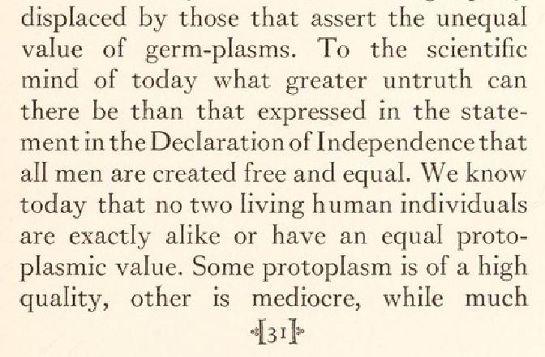
Excerpt from Warthin’s pamphlet, The Creed of a Biologist (1930)

Slide 17
Riverwalk Apartments, 2006 Photo by John R. Gentry, Jr. DSC_6355

Slide 18
Charles P. Emerson (1872-1938) Dean, IU School of Medicine 1911-1932 Photo by Jessie Groves UA24-002589

Slide 19
Charles P. Emerson UA24-002590

Slide 20
Charles P. Emerson with social work students making rounds in Long Hospital, ca. 1920s UA24-002603

Slide 21
Emerson Hall under construction, ca. 1918 UA24-003761

Slide 22
Isaac Blackford (1786-1859)

Slide 23
Blackford Street Parking Garage at NW corner of Blackford and Michigan Streets, 2006 IMG_155_RT8

Slide 24
Indiana Historical Bureau Marker at corner of Blackford and New York Streets

Slide 25
Riverwalk Apartments, 2004 Photo by John R. Gentry, Jr. _DSC1448

Slide 26
Inlow Hall, 2016 Photo by Liz Kaye 20160325_McKinney_Hall_Exterior_Night_LK-48

Slide 27
Indianapolis Star, May 23, 1997, page D14

Slide 28
Groundbreaking ceremony for Lawrence W. Inlow Hall, 1999 Photo by Rick Baughn 499-7413-059

Slide 29
Consult an Archivist! speccoll@iupui.edu Stephen E. Towne setowne@iupui.edu

